Slide 1
Group Meeting 4

Slide 2
Previously
Identified race no. as a potential factor in market accuracy.
Implemented some betting strategies.
Identified a larger data set which may be of use.

Slide 3
New
Implemented code capability to test statistics against any imaginable categorisation of races.
  Distance
  Time of day
  Trade volume
  Race type (Handicap, Chase, Hurdles, etc.)
  Venue
Added new rigorous tests to identify market forecast accuracy. Brier score, Log Loss.
New even larger dataset (completely free) → 25k events, 175k races, 1.6m runners.

Slide 4
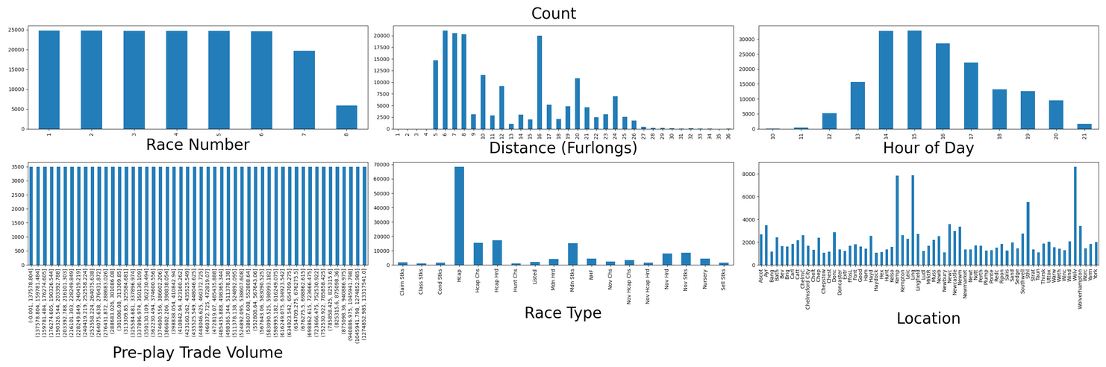
Overview of Categories

Slide 5
Brier Score
Originally formulated to analyse the accuracy of weather forecasts.
Brier score is essentially Ranked Probability Score but with two categories.
A blind 50/50 guess results in a score of 0.25 → perfect score is 0.
[1] G. W. Brier, ‘Verification of forecasts expressed in terms of probability’, Mon. Weather Rev., vol. 78, no. 1, pp. 1–3, Jan. 1950, doi: 10.1175/1520-0493(1950)078%3C0001:VOFEIT%3E2.0.CO;2.
[2] A. P. Weigel, M. A. Liniger, and C. Appenzeller, ‘The discrete brier and ranked probability skill scores’, Mon. Weather Rev., vol. 135, no. 1, pp. 118–124, Jan. 2007, doi: 10.1175/MWR3280.1.
Notes:
Brier score works for this use case as even though a horse race contains n racers, each one actually acts as a separate market with a binary outcome (win/not win).

Slide 6
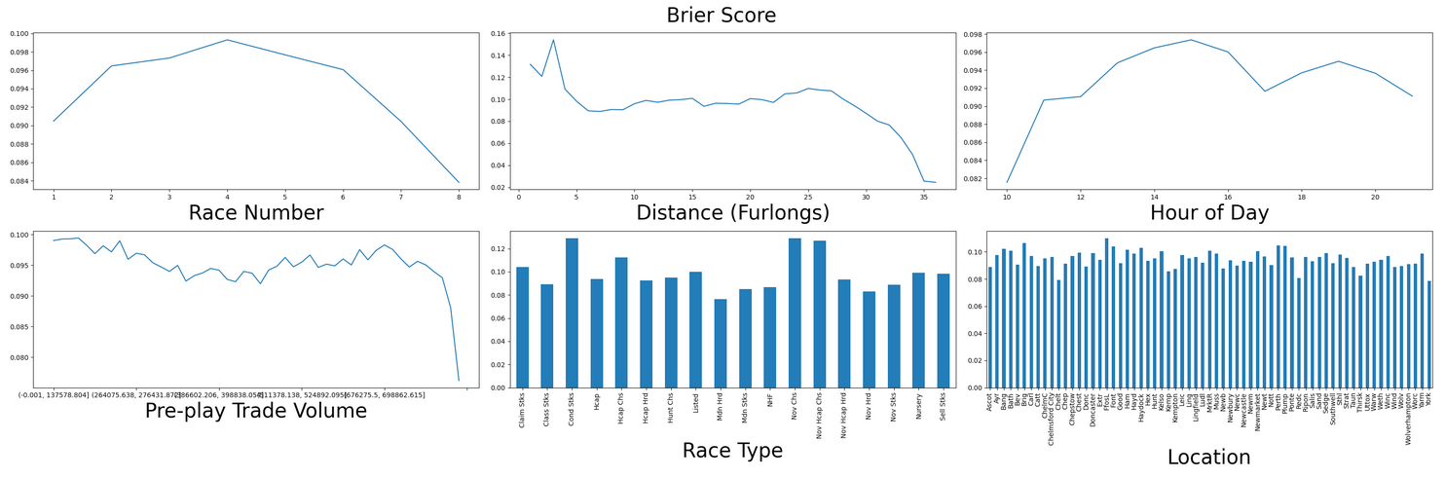

Slide 7
Log Loss
Primarily used in a machine learning context nowadays.
Significantly punishes overconfidence.
Like Brier, close to 0 is closer to perfect.

Slide 8
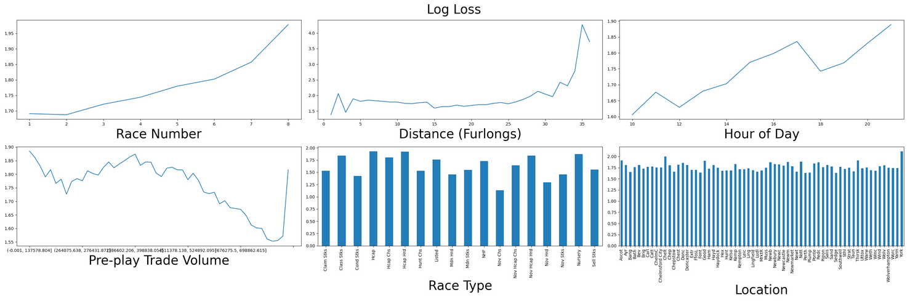

Slide 9
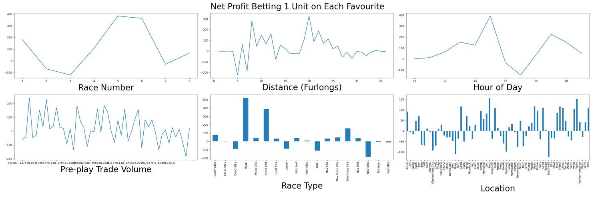
Betting Strategy Results
About what you would expect when betting randomly

Slide 10
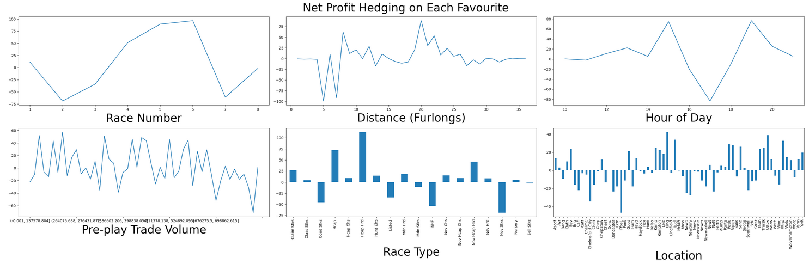
Betting Strategy Results
About what you would expect when betting randomly

Slide 11
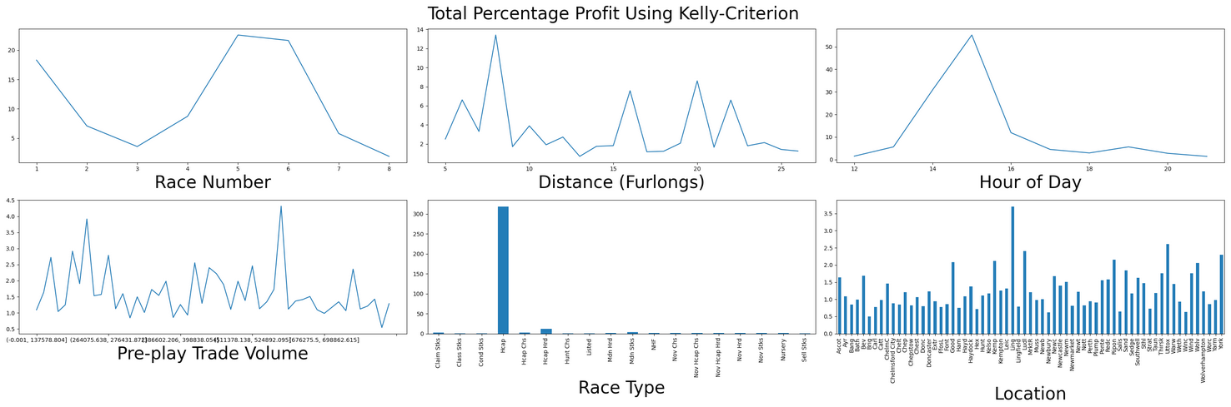
My Simple Learning Strategy
As Hausch et al. (1981) suggest, the existence of a profitable strategy indicates the market is not efficient.
[1] D. B. Hausch, W. T. Ziemba, and M. Rubinstein, ‘Efficiency of the market for racetrack betting’, Manag. Sci. (pre-1986), vol. 27, no. 12, p. 1435, Dec. 1981, doi: 10.1287/mnsc.27.12.1435.

Slide 12
To do
Utilise Brier and Ranked Probability Skill Scores to more explicitly compare Brier scores for different groupings.
Add investment metrics (e.g. Sharpe ratio) to determine the effectiveness of the betting strategies.
Play with different configurations of the betting strategy (bet size, rolling window size, computation of forecasted probabilities).
Finish reimplementation of some of the previous tests to work with the new data.
Look into other metrics of market accuracy and efficiency.
Look at implementing more strategies such as those from Hausch, Ritter, etc. and comparing across groups

